Slide 1
RefurbTrack
Phone refurbishment cost and profit tracking
AJ Cellphone Repair Shop and Accessories
CCE 106/L • UM Tagum College
1 / 11
Notes:
Title
Timing: 0:00–0:15
Good evening. We are the RefurbTrack team from UM Tagum College. Our project helps AJ Cellphone Repair Shop and Accessories keep each phone’s costs and outcome together. We focus on the shop’s repair and resale work.
Sources: supplied RefurbTrack concept paper, instructor pitching guide and announcements; repository implementation and recorded tests. All financial examples are fictional. Review the latest verification report before presenting deployment status.

Slide 2
The problem
A sale price does not reveal the profit
Purchase, parts, and labor are recorded separately.
Unexpected defects add costs.
Unsold phones keep capital tied up.
2 / 11
Notes:
Overview · Problem
Timing: 0:15–0:50
Our concept paper reports a needs assessment with the shop owner on August twenty-three. Records were spread across memory, paper, and an inconsistent existing application. Buying, repairing, and reselling phones was the greatest difficulty. Another discovered defect changes the investment. Without keeping those costs together, a sale can appear successful even when it produces a loss. This is evidence from one beneficiary, not every repair shop.
Sources: supplied RefurbTrack concept paper, instructor pitching guide and announcements; repository implementation and recorded tests. All financial examples are fictional. Review the latest verification report before presenting deployment status.

Slide 3
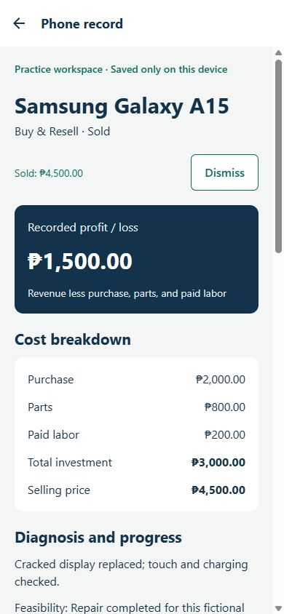
The solution
One phone record through its whole job
Intake and diagnosis
Parts and paid labor
Final payment and history
Fictional example
PHP 4,500 revenue − PHP 3,000 costs
= PHP 1,500 profit
3 / 11
Notes:
Overview · Solution
Timing: 0:50–1:25
RefurbTrack keeps intake, diagnosis, expenses, status, and final payment together. In our fictional demonstration, purchase costs two thousand pesos, parts cost eight hundred, and paid labor costs two hundred. Investment totals three thousand pesos. Revenue of four thousand five hundred produces one thousand five hundred pesos recorded profit. Rent, tax, and overhead are excluded. An unsold job shows investment, not an automatic realized loss.
Sources: supplied RefurbTrack concept paper, instructor pitching guide and announcements; repository implementation and recorded tests. All financial examples are fictional. Review the latest verification report before presenting deployment status.

Slide 4
Project objectives
Make the recorded costs usable at the counter
Record and update the actual direct costs
Separate resale from customer repairs
Retrieve a phone’s status and financial history
4 / 11
Notes:
Overview · Objectives
Timing: 1:25–1:50
Our objectives are to record actual direct costs, separate the two job types, and retrieve each phone’s history. Buy and Resell and Customer Repair are explicit choices. A free acquisition still follows resale; a customer repair ends with release. Our intake target is under two minutes, pending timed tests with actual users.
Sources: supplied RefurbTrack concept paper, instructor pitching guide and announcements; repository implementation and recorded tests. All financial examples are fictional. Review the latest verification report before presenting deployment status.

Slide 5
Market opportunity
Begin with the shop that identified the need
Primary users: the owner and technicians
Initial setting: one repair shop in Tagum City
Wider demand has not yet been measured
5 / 11
Notes:
Market · Market Opportunity
Timing: 1:50–2:15
Our initial users are the owner and technicians of AJ Cellphone Repair Shop and Accessories in Tagum City. The opportunity is to replace fragmented records at this shop. Other shops may face a similar problem, but wider demand and market size have not been measured. We will validate this beneficiary’s workflow first.
Sources: supplied RefurbTrack concept paper, instructor pitching guide and announcements; repository implementation and recorded tests. All financial examples are fictional. Review the latest verification report before presenting deployment status.

Slide 6
Existing alternatives
The distinction is the per-phone workflow
Paper or memory: flexible, but costs can be scattered
Spreadsheet: flexible, but the workflow needs setup
RefurbTrack: intake, direct costs, status, and outcome together
6 / 11
Notes:
Market · Competition
Timing: 2:15–2:40
Paper and memory need little setup, but the survey describes fragmented records. A spreadsheet is a valid alternative, although its workflow needs to be designed and maintained. RefurbTrack organizes intake, costs, status, and outcome around each phone. This is a comparison of our implemented workflow, not a claim that all commercial systems lack these functions.
Sources: supplied RefurbTrack concept paper, instructor pitching guide and announcements; repository implementation and recorded tests. All financial examples are fictional. Review the latest verification report before presenting deployment status.

Slide 7
System architecture
Android client with Firebase services
React Native + Expo: interface and calculations
Firebase Authentication: staff identity
Cloud Firestore: workspace records and access rules
7 / 11
Notes:
Market · Architecture
Timing: 2:40–3:10
React Native and Expo provide the Android interface. Firebase Authentication identifies staff, and Firestore stores workspace records. Shared access requires administrator-provisioned membership. Money is stored as whole centavos. A revision check prevents an old form from silently overwriting a newer update. Practice mode follows the same calculations but saves only on this device, separately from cloud records.
Sources: supplied RefurbTrack concept paper, instructor pitching guide and announcements; repository implementation and recorded tests. All financial examples are fictional. Review the latest verification report before presenting deployment status.

Slide 8
Development process
Build and check the complete phone lifecycle
Requirements and financial rules
Intake, expenses, progress, and final payment
Testing, APK packaging, and rehearsal
8 / 11
Notes:
Market · Development Process
Timing: 3:10–3:35
We defined the lifecycles and financial rules from the concept paper, then connected the screens. Automated tests cover free acquisitions, expense corrections, and below-cost sales. Browser walkthroughs verify the displayed result. Cloud verification and an installed Android APK are separate release checks. The mock presentation will guide refinements before final submission.
Sources: supplied RefurbTrack concept paper, instructor pitching guide and announcements; repository implementation and recorded tests. All financial examples are fictional. Review the latest verification report before presenting deployment status.

Slide 9
Traction and validation
Working software, with device and client checks next
20 financial and workflow tests passed
Cloud access checks passed; Android APK built
Client acceptance and installed-device checks remain
9 / 11
Notes:
Status · Traction and Validation
Timing: 3:35–4:10
Our concept paper reports a needs assessment with one shop owner. We now have twenty passing financial and workflow tests, live Firebase access checks, and a completed Android APK build. A cloud repair test survived a browser reload with the correct profit. We still need to record physical-device results and the client’s acceptance. We have not claimed increased sales or measured time savings.
Sources: supplied RefurbTrack concept paper, instructor pitching guide and announcements; repository implementation and recorded tests. All financial examples are fictional. Review the latest verification report before presenting deployment status.

Slide 10
Market strategy
A supervised pilot before wider use
Orient the owner and technicians
Run real acceptance tasks with permission
Use feedback to decide the next release
10 / 11
Notes:
Status · Market Strategy
Timing: 4:10–4:35
Our rollout begins with a supervised pilot. We will orient the owner and technicians, explain the calculation’s limits, and collect corrections from agreed tasks. No commercial price or paying-user claim has been established. Photos and inventory can follow validated needs. Free scrcpy mirroring can help demonstrate the installed app during class.
Sources: supplied RefurbTrack concept paper, instructor pitching guide and announcements; repository implementation and recorded tests. All financial examples are fictional. Review the latest verification report before presenting deployment status.

Slide 11
The team
RefurbTrack • UM Tagum College
Joseph D. Alejo
Ynoid Dan M. Blagantio
Ace Jerald C. Galvez
Novecille Lapasaran
11 / 11
Notes:
Status · Team
Timing: 4:35–5:00
Our team is Joseph Alejo, Ynoid Dan Blagantio, Ace Jerald Galvez, and Novecille Lapasaran. Together we are responsible for implementation, testing, documentation, and presentation. Individual contributions should follow our actual assignments. We will now demonstrate a fictional phone, its recorded costs and profit, then the customer repair workflow. Thank you.
Sources: supplied RefurbTrack concept paper, instructor pitching guide and announcements; repository implementation and recorded tests. All financial examples are fictional. Review the latest verification report before presenting deployment status.

